Slide 1
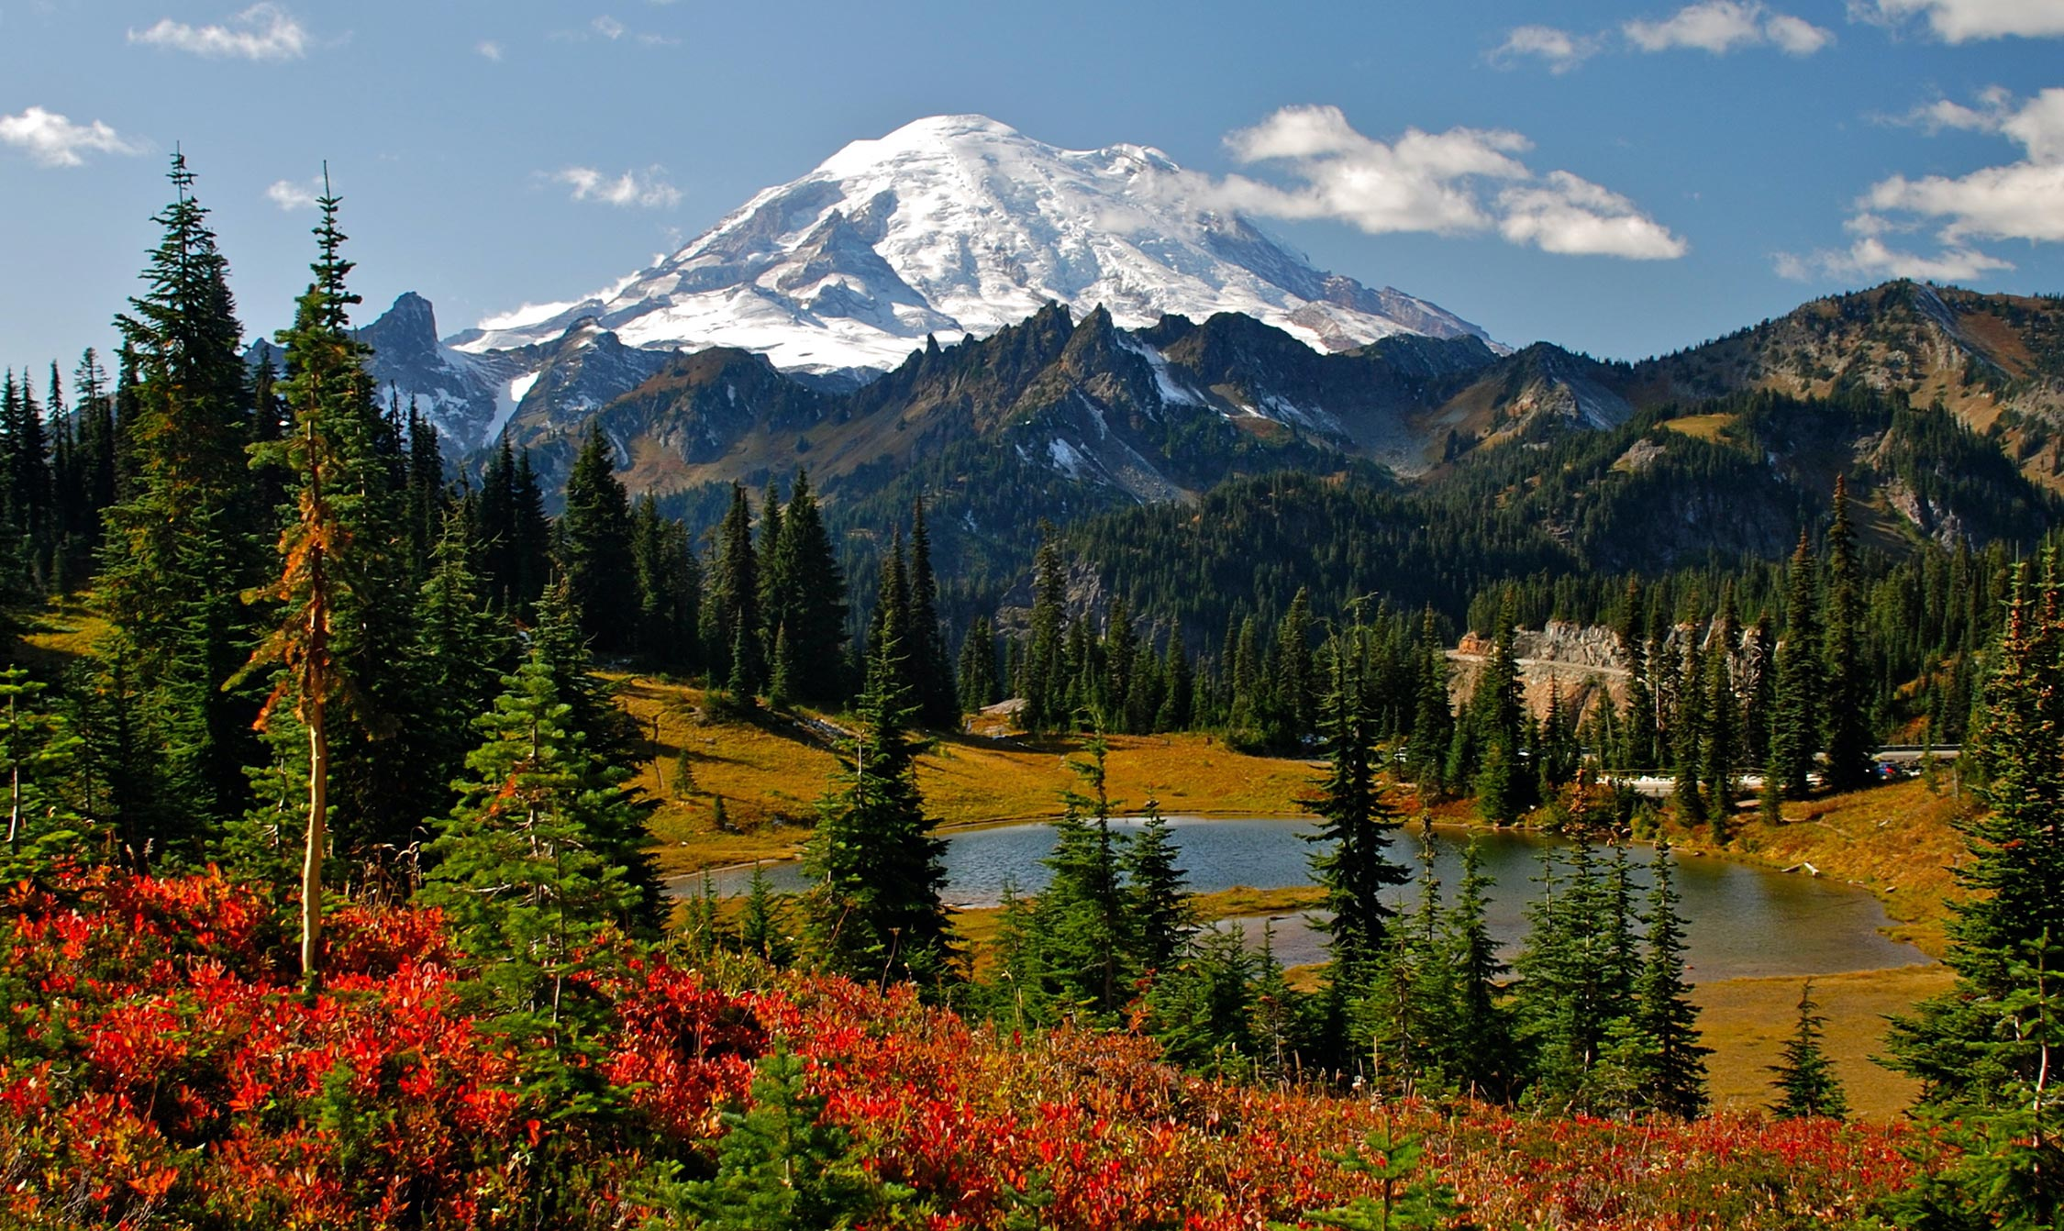
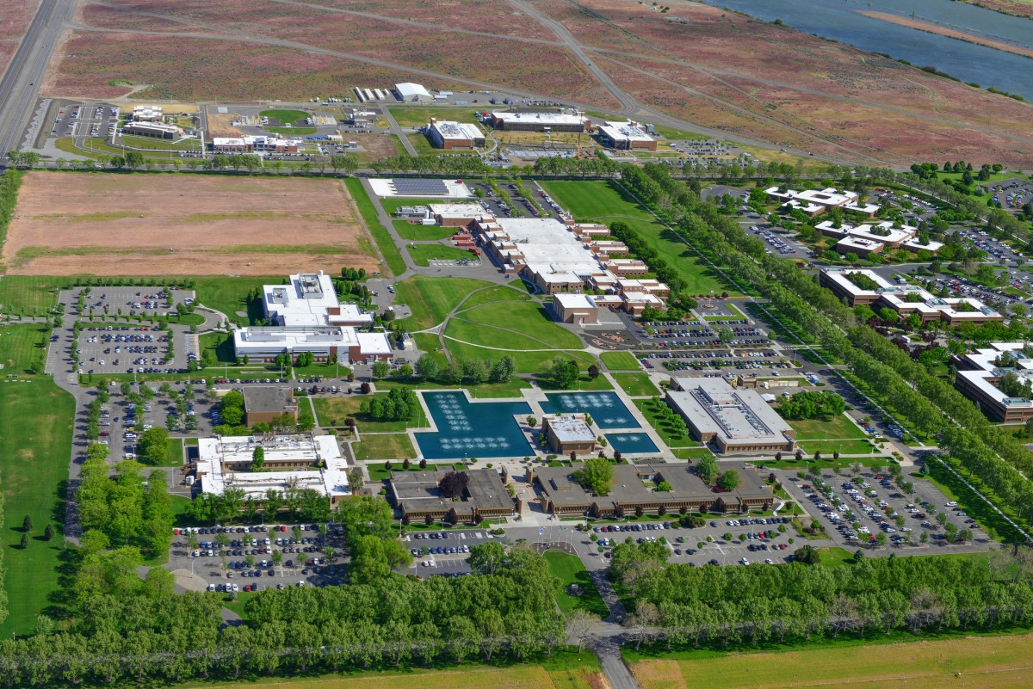
Neural Lyapunov Differentiable Predictive Control
61st IEEE Conference on Decision and Control
Dec. 6-9, 2022, in Cancún, Mexico
Sayak Mukherjee, Jan Drgona, Aaron Tuor,
Mahantesh Halappanavar, Draguna Vrabie

Slide 2
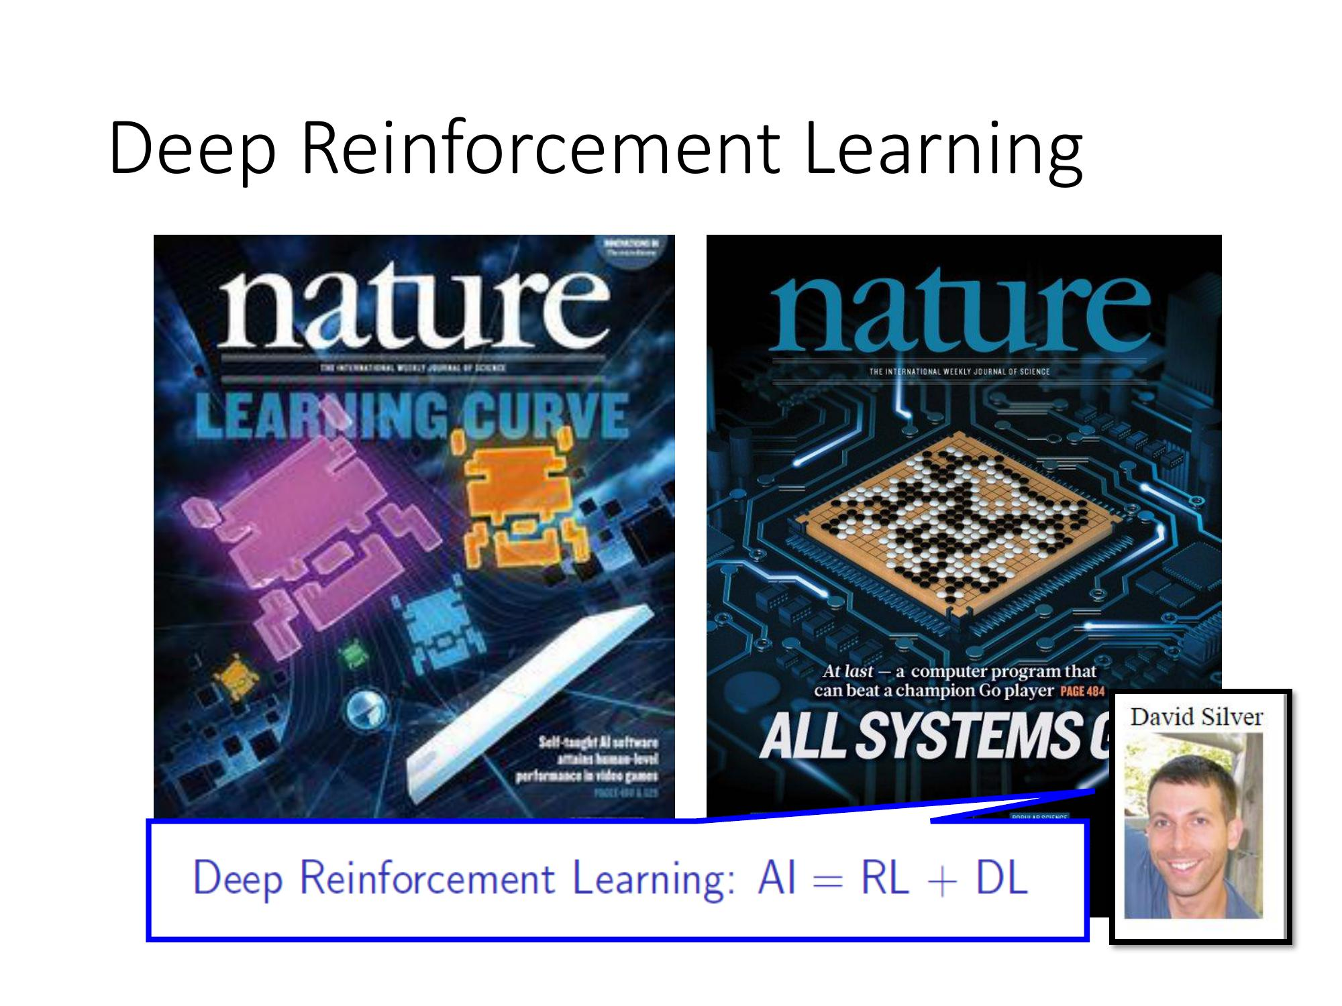
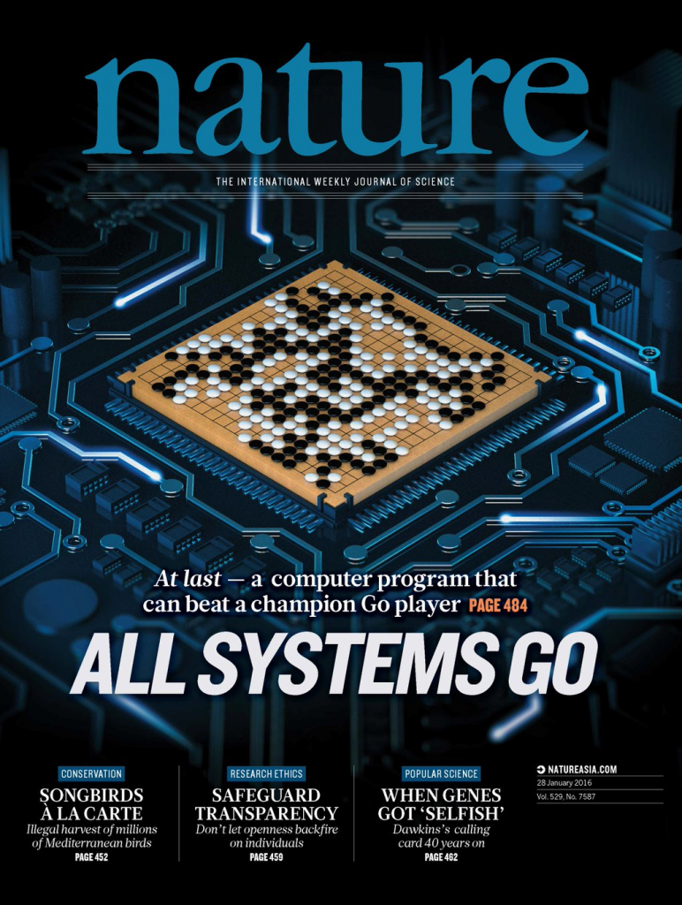
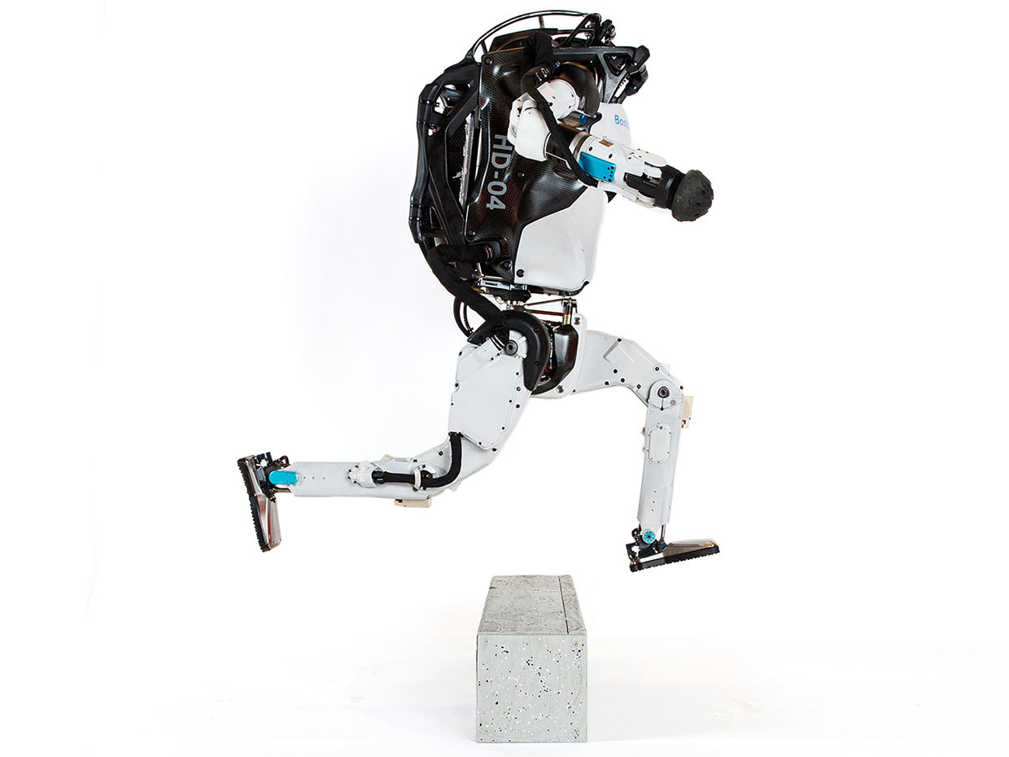
Modern Control Methods
Model Predictive Control
Reinforcement Learning
95% of the industrial control applications are PID loops & expert driven rule-based control (RBC).
The rest is model predictive control (MPC).
Everywhere where you have reliable digital environment model, mostly discrete action space, and you can use massive compute to solve the problem.
Drgona J., et al. 2020. "All You Need to Know About Model Predictive Control for Buildings." Annual Reviews in Control, September 29, 2020
G. Dulac-Arnold, D. J. Mankowitz, and T. Hester, “Challenges of real-world reinforcement learning,”, 2019.

Slide 3

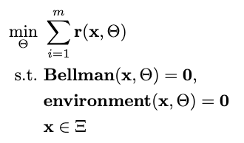

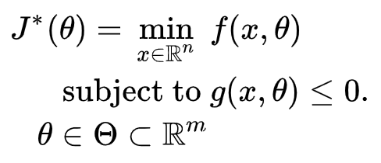

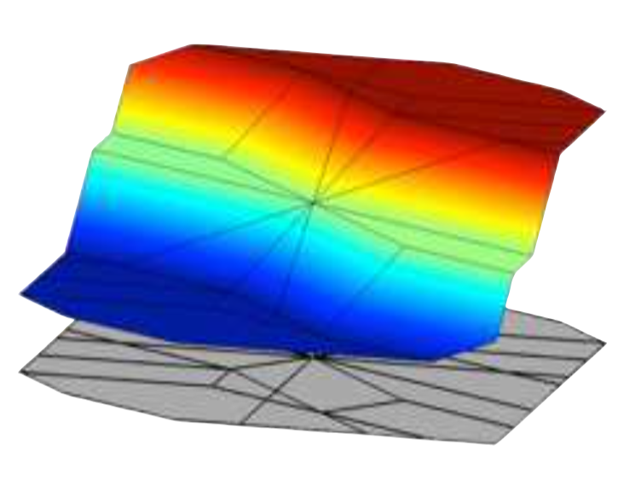
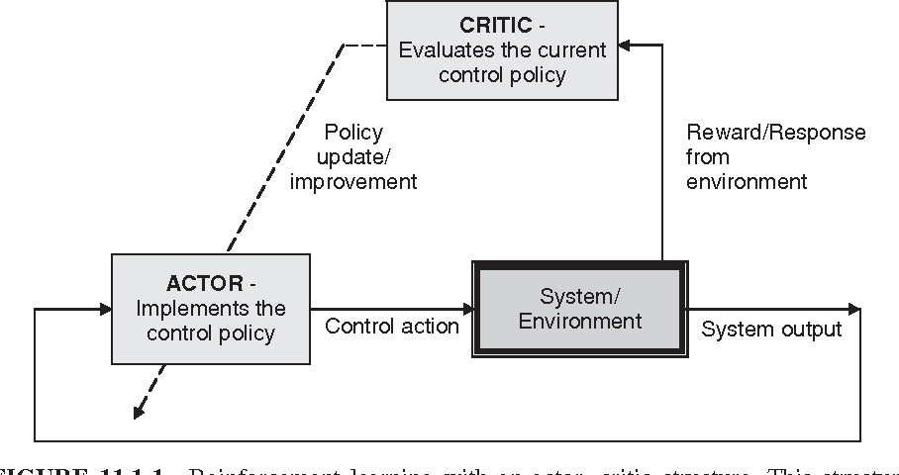

Optimization Methods for Control
Online MPC
Explicit MPC
Imitation Learning
Reinforcement Learning
“online” optimization
single solution for
given parameter values
implicit policy
“offline” optimization obtains a solution map
for a set of parameters
classical methods lead to exponential complexity!
“offline” optimization
obtains a model (map)
for a set of data points
scalable but requires expert controller
“offline” optimization
obtains a policy map
for a set of data points
poor convergence and
can’t handle constraints

Slide 4
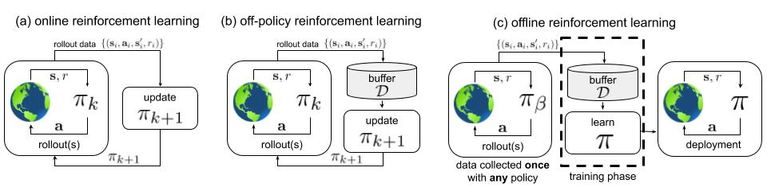
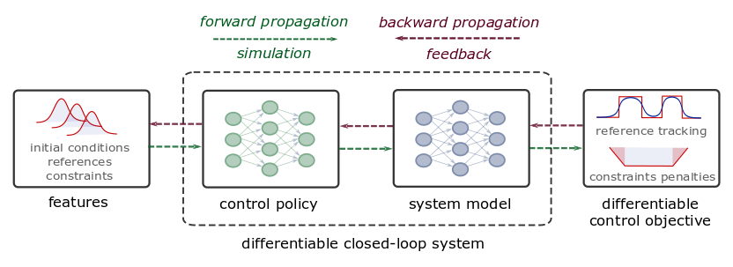
Differentiable Predictive Control
Reinforcement Learning
Online
Off-policy
Offline
Model-based, model-free
Learn: policy, Q function, model
Gradients via Q functions
https://arxiv.org/abs/2005.01643
Differentiable Predictive Control (DPC)
Train offline
Online on/off-policy updates
Constrained, model-based
Learn: policy, model, (objectives, constraints)
Gradients via differentiable MPC constraints and objectives
Stability analysis on closed-loop dynamics
Jan Drgona, et al., Differentiable Predictive Control: An MPC Alternative for Unknown Nonlinear Systems using Constrained Deep Learning, Journal of Process Control, 2022

Slide 5
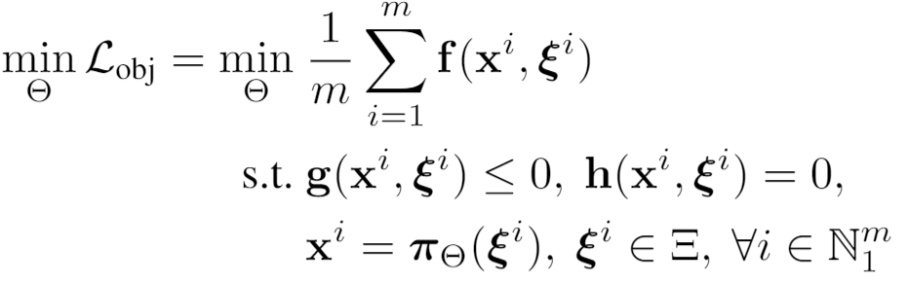
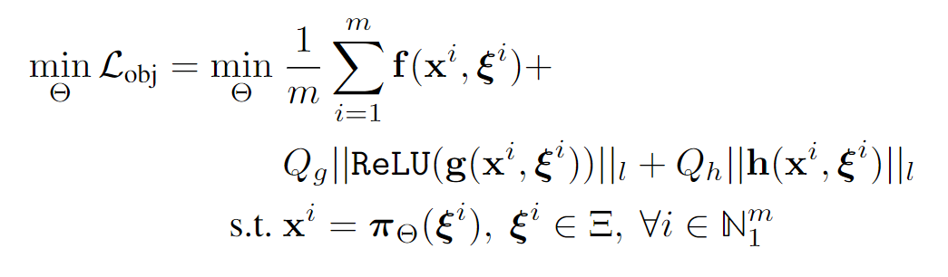
Parametric Optimization via Differentiable Programming: Generalization of PINNs
Objective function
Problem formulation:
Constraints
Primal optimizers
Scenarios
Solution map
Parameters
Lagrangian form:
Constraints penalties
Gradient-based optimization based on AD

Slide 6
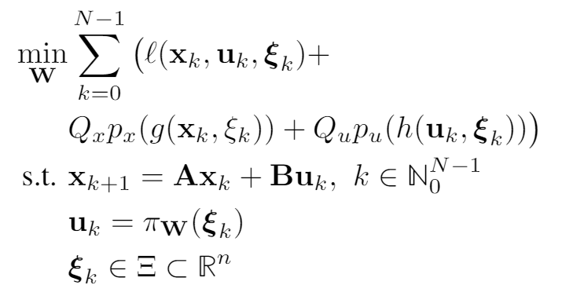
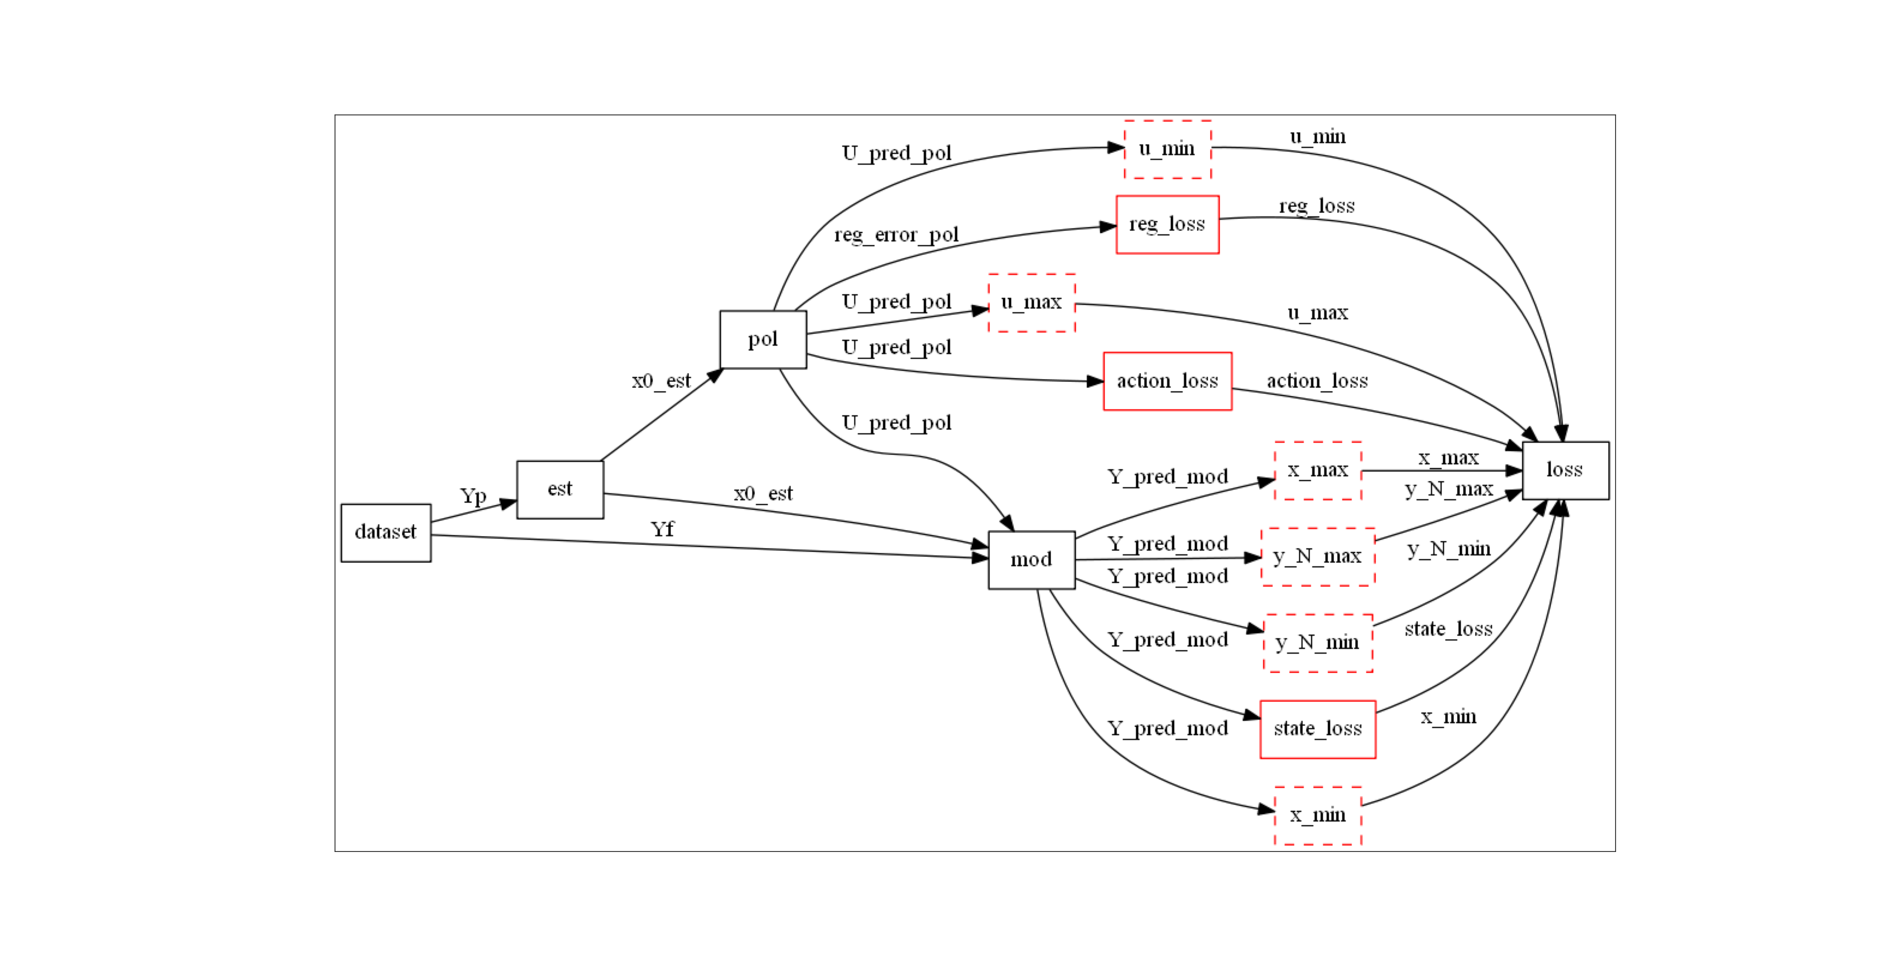
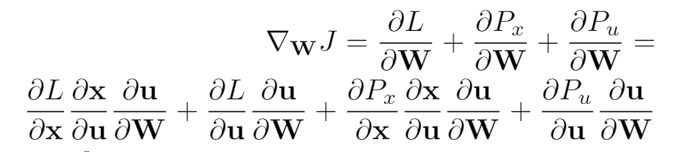
Differentiable Computational Graphs and Model-based Policy Gradients
Differentiate the computational graph to train the policies using state-of-the-art deep learning tools.

Slide 7
Differentiable Computational Graphs and Model-based Policy Gradients
Differentiate the computational graph to train the policies using state-of-the-art deep learning tools.

Slide 8
Differentiable Computational Graphs and Model-based Policy Gradients
Differentiate the computational graph to train the policies using state-of-the-art deep learning tools.

Slide 9
Differentiable Computational Graphs and Model-based Policy Gradients
Differentiate the computational graph to train the policies using state-of-the-art deep learning tools.

Slide 10
Differentiable Computational Graphs and Model-based Policy Gradients
Differentiate the computational graph to train the policies using state-of-the-art deep learning tools.

Slide 11
Differentiable Computational Graphs and Model-based Policy Gradients
Differentiate the computational graph to train the policies using state-of-the-art deep learning tools.

Slide 12
Differentiable Computational Graphs and Model-based Policy Gradients
Differentiate the computational graph to train the policies using state-of-the-art deep learning tools.

Slide 13
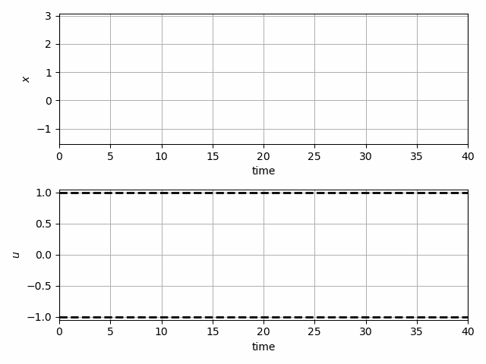
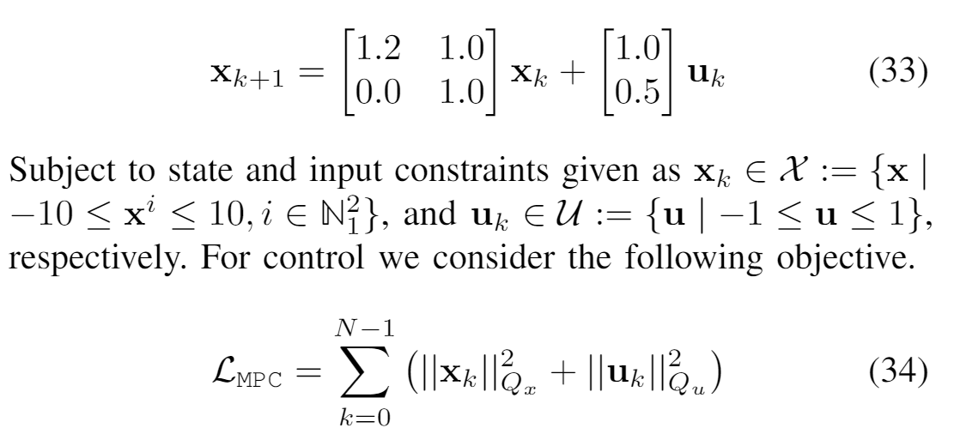
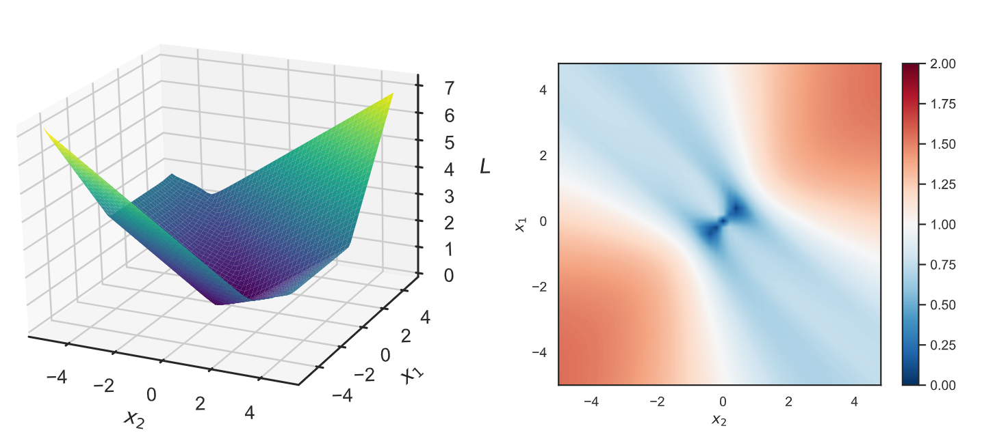
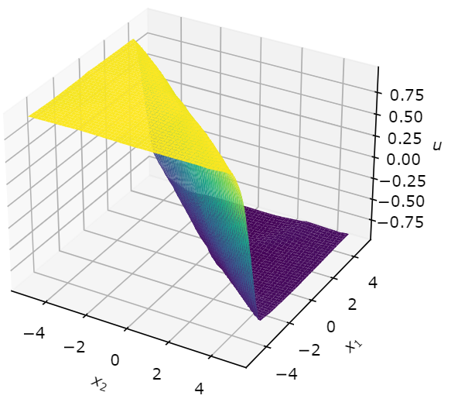
Learning to Stabilize Unstable System with DPC
Problem setup:
DPC formulation:
Drgona J., Tuor A., Vrabie D., Learning Stable Adaptive Explicit Differentiable Predictive Control for Unknown Linear Systems, under review, 2021

Slide 14
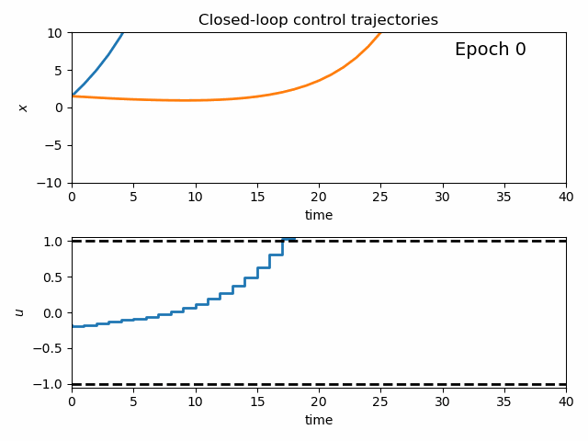
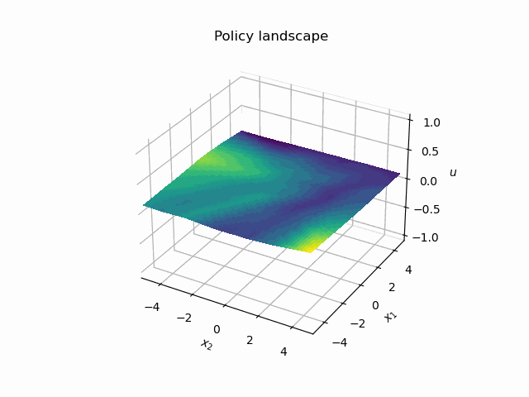
Dynamics of DPC Control Policy Learning
1341 learning parameters, 48.2 seconds offline training time on a CPU with 200 epochs.
Drgona J., Tuor A., Vrabie D., Learning Stable Adaptive Explicit Differentiable Predictive Control for Unknown Linear Systems, under review, 2021

Slide 15
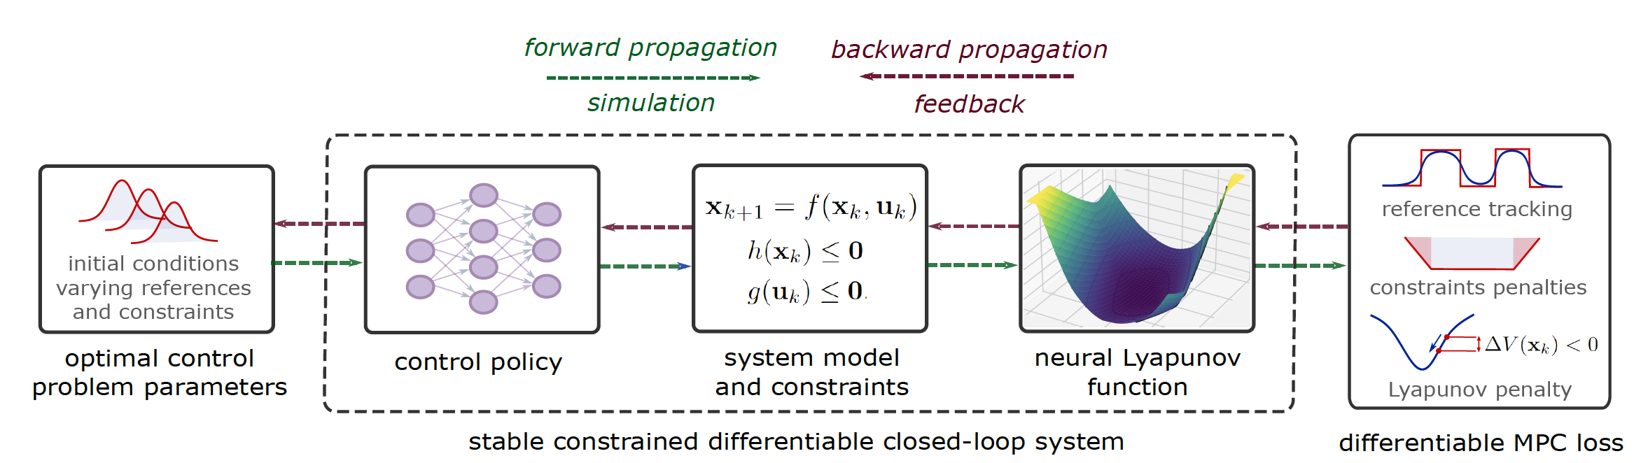
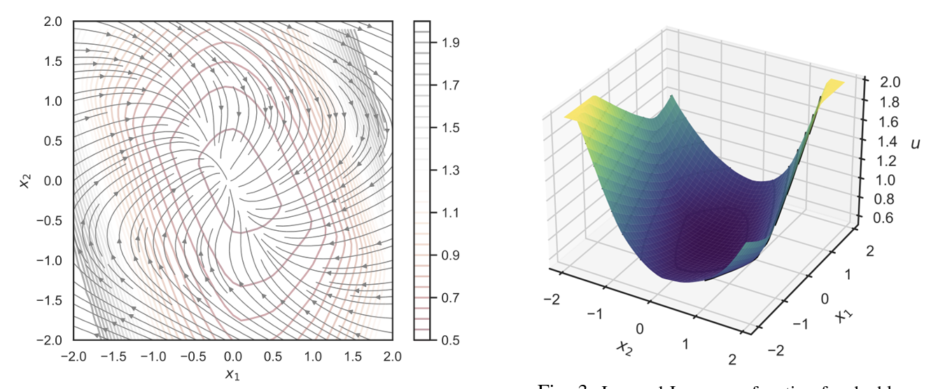
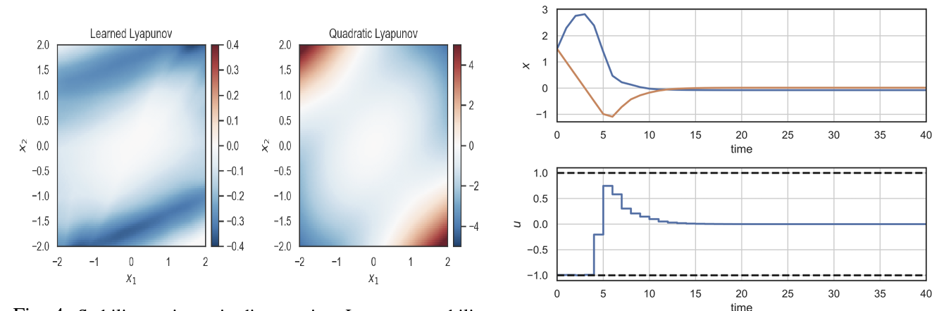
Learning Stable Policies via Neural Lyapunov Differentiable Predictive Control
Sayak Mukherjee, Ján Drgoňa, Aaron Tuor, Mahantesh Halappanavar, Draguna Vrabie, Neural Lyapunov Differentiable Predictive Control, IEEE CDC, 2022

Slide 16
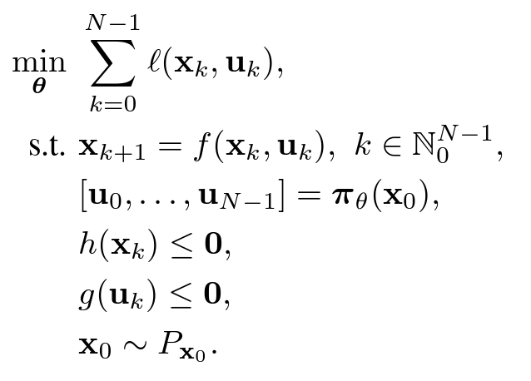
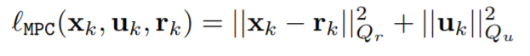
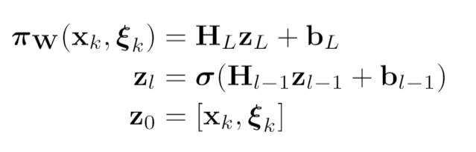
Mathematical framework
Mathematical Framework of Neural Lyapunov DPC
Objective function
Dynamics
Lower-level
MPC objective function
Predictive policy
Dynamic constraints
Neural control policy
Sayak Mukherjee, Ján Drgoňa, Aaron Tuor, Mahantesh Halappanavar, Draguna Vrabie, Neural Lyapunov Differentiable Predictive Control, IEEE CDC, 2022

Slide 17
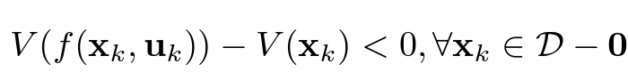
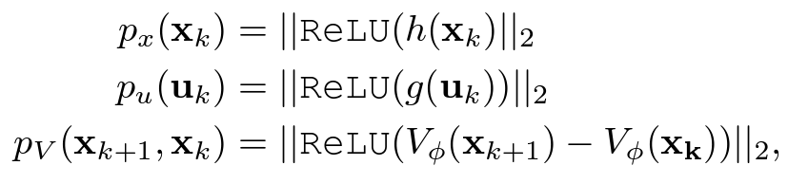
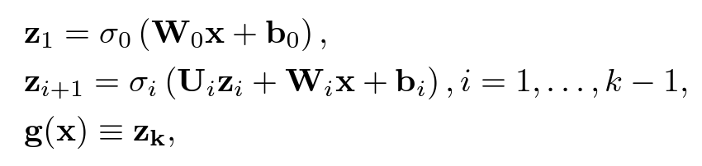
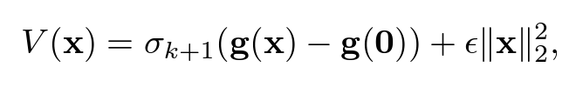
Mathematical framework
Mathematical Framework of Neural Lyapunov DPC
Objective function
Dynamics
Lower-level
MPC objective function
Predictive policy
Dynamic constraints
Neural control policy
Lyapunov condition:
Implementation via input-convex NNs
Input Convex Neural networks (ICNN)
Soft state, control, and Lyapunov constraints
Sayak Mukherjee, Ján Drgoňa, Aaron Tuor, Mahantesh Halappanavar, Draguna Vrabie, Neural Lyapunov Differentiable Predictive Control, IEEE CDC, 2022

Slide 18
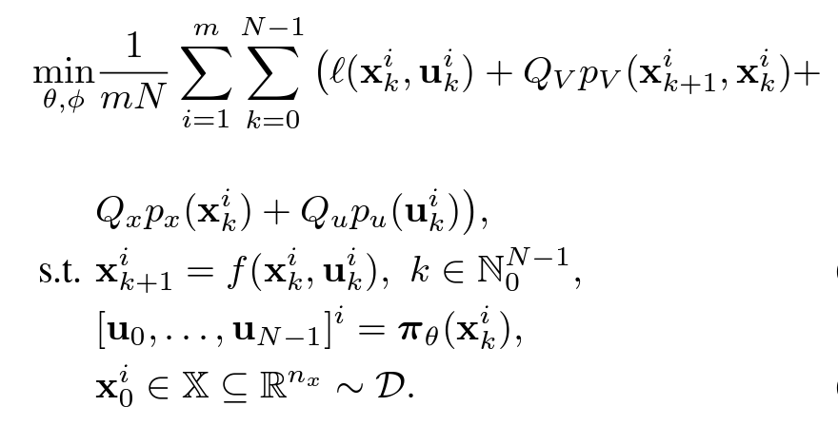
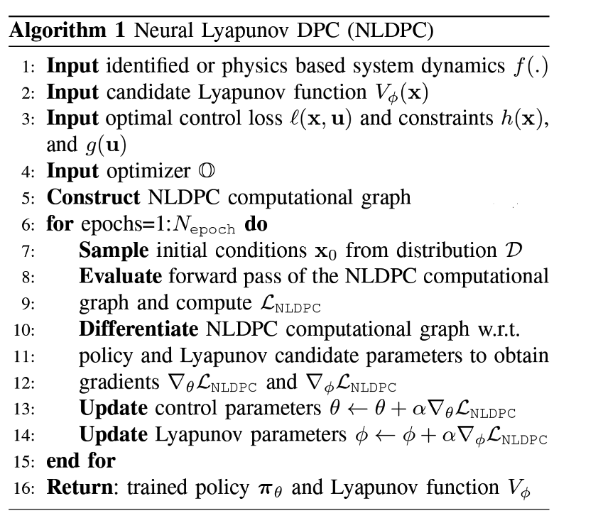
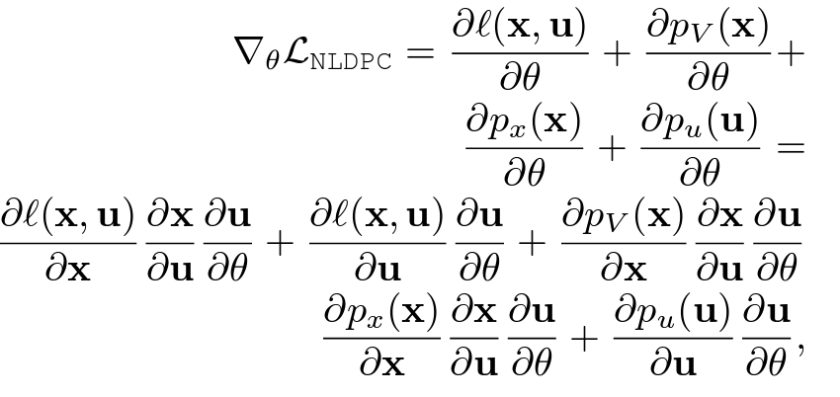
Mathematical framework and learning algorithm
Neural Lyapunov DPC Learning Algorithm
NLDPC problem:
Learning Algorithm
Policy Gradients
Gradient flows:
Sayak Mukherjee, Ján Drgoňa, Aaron Tuor, Mahantesh Halappanavar, Draguna Vrabie, Neural Lyapunov Differentiable Predictive Control, IEEE CDC, 2022

Slide 19
Experiments: stabilizing double integrators
Experiments: Stabilizing Double Integrator
Phase portrait with overlaid Lyapunov contours
Learned closed-loop Lyapunov
Stability regions via discrete-time Lyapunov conditions
Closed-loop state and control trajectories

Slide 20
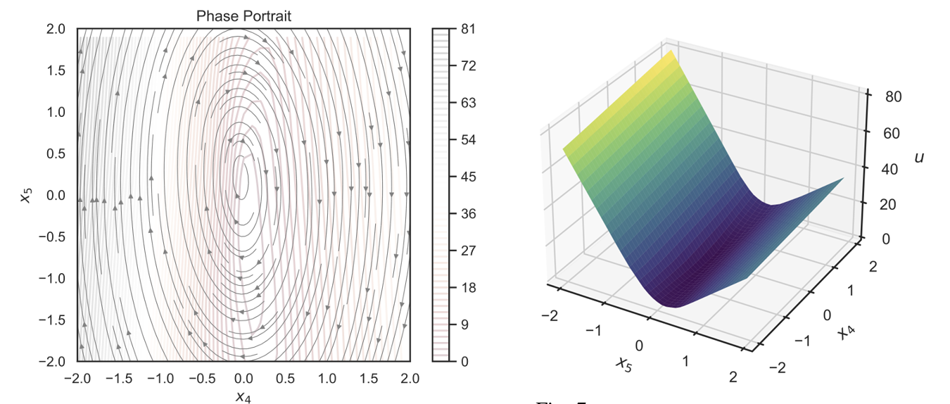
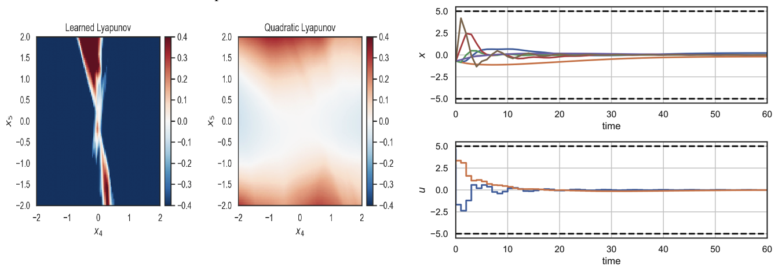
Experiments: Controlling PVTOL aircraft (Visualized on 2D slices of 6D state space)
Experiments: Controlling PVTOL aircraft model
Phase portrait with overlaid Lyapunov contours
Learned closed-loop Lyapunov
Stability regions via discrete-time Lyapunov conditions
Closed-loop state and control trajectories

